Slide 1
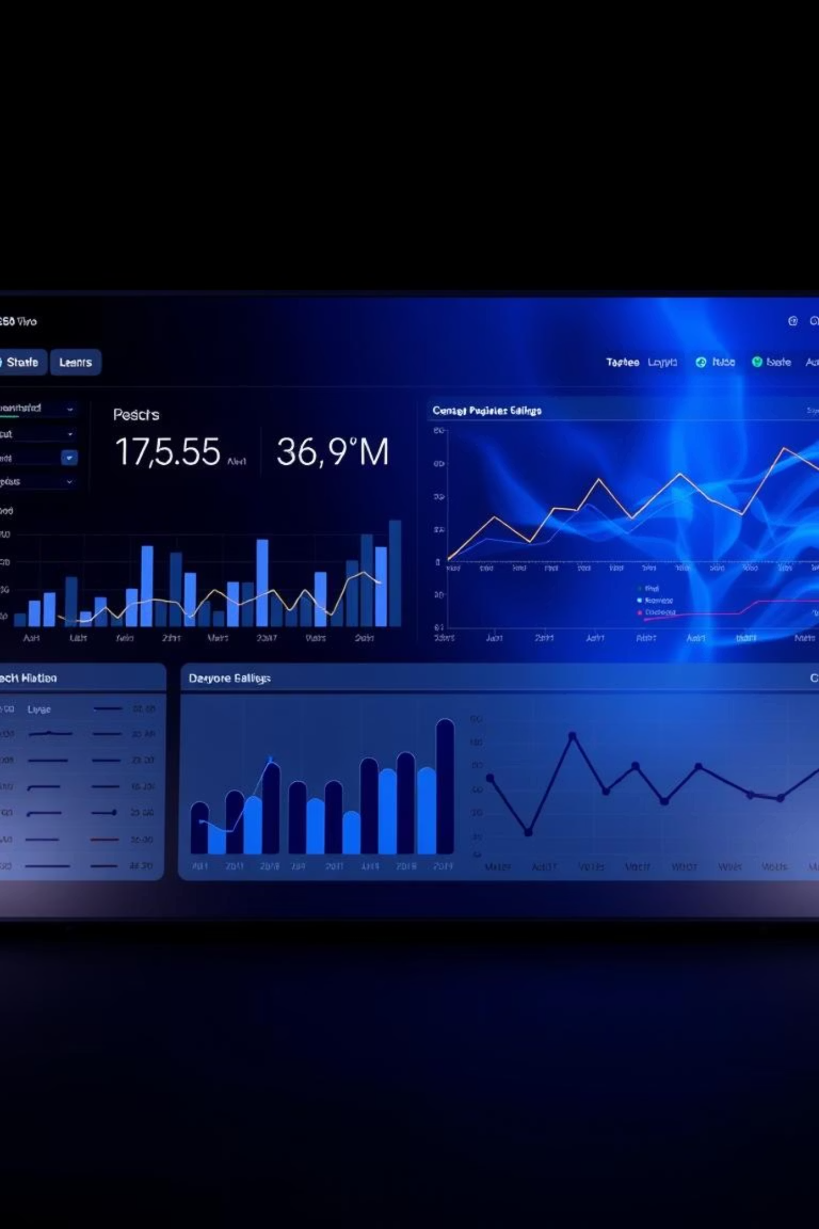
IT TICKET ANALYSIS
Welcome to our deep dive into IT support data. We'll analyze key metrics, identify improvement areas, and recommend strategic investments to enhance service delivery and employee satisfaction.
By SAHIL SINGH

Slide 2
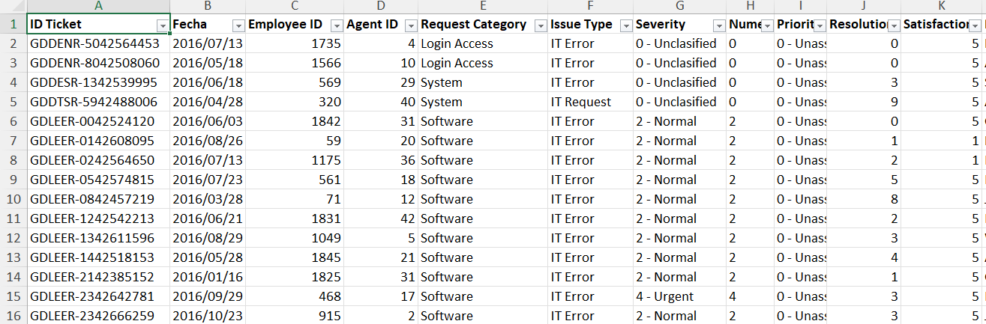
PROBLEM STATEMENT
The objective is to analyze the IT support ticket management system to understand the performance of IT agents, the efficiency of ticket resolution, and the satisfaction levels of employees. The analysis aims to identify high and low performers among IT agents, assess the overall effectiveness of the team, and pinpoint areas for improvement in the ticket resolution process. The ultimate goal is to make informed staffing decisions, including hiring, firing, and training, to enhance overall service quality and team performance.

Slide 3

DATA OVERVIEW
Ticket ID : Unique identifier for each ticket
Date : Date of creation of the ticket
Agent ID : Unique identifier for agents
Employee ID : Unique identifier for employees who raised the ticket
Priority : Levels such as Low, Medium, High
Type : Such as Login Access or Login Request
Category : Hardware, Software, System etc
Resolution time : Time taken to resolve the issue
Satisfaction Rating : Ratings given by employees based on their satisfaction level

Slide 4
Addressing Data Inconsistencies
Used the date function to obtain the DOB of agents in IT Agents sheet.
Calculated the age of the employees in IT Agents sheet.
Found for duplicate entries, but no duplicates values found.
Column: Severity
Column: Priority
Correction Method
Spelling errors found:
Spelling error found:
Excel's "Check Spelling" feature under the Review Ribbon ensures data integrity.
Unclasified: 356 instances
Unassiged: 29,410 instances
Mayor: 4,836 instances
Correcting these inconsistencies is crucial for accurate analysis and reporting.

Slide 5
DATA ANALYTICAL APPROACH
Data cleaning : Used remove duplicates feature to ensure data accuracy, checked for any missing or blank values using Conditional formatting
Data enrichment : Used XLOOKUP to extract the agents name from the other sheet, using AVERAGE function calculated the average age of employees and also DATE function to format the date
Descriptive Analysis : Employed Pivot tables for summarizing key metrics and identifying patterns
Trend Analysis : Conducted time series analysis using line chart to understand the performance of IT agents over time
Visualization : Created dynamic charts and dashboards for data representation, enabling interactive data exploration

Slide 6
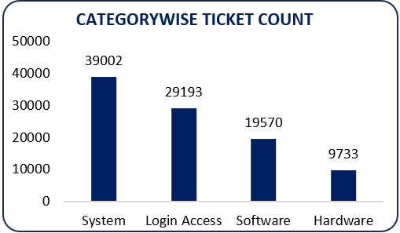
VISUALISATIONS
Ticket Category Distribution
Highest: System (40%)
Lowest: Hardware (10%)
Login Access & Software: 52% combined
These metrics highlight workload and resource allocation needs for IT agents.

Slide 7
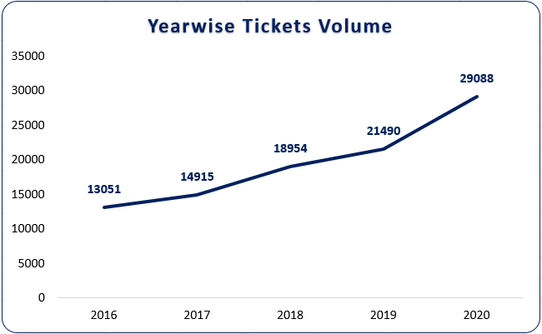
YEARLY TICKETS DISTRIBUTION
Steady growth in ticket volume over the past 5 years
A significant jump in 2020, possibly due to external factors like
remote work shifts during the pandemic.

Slide 8
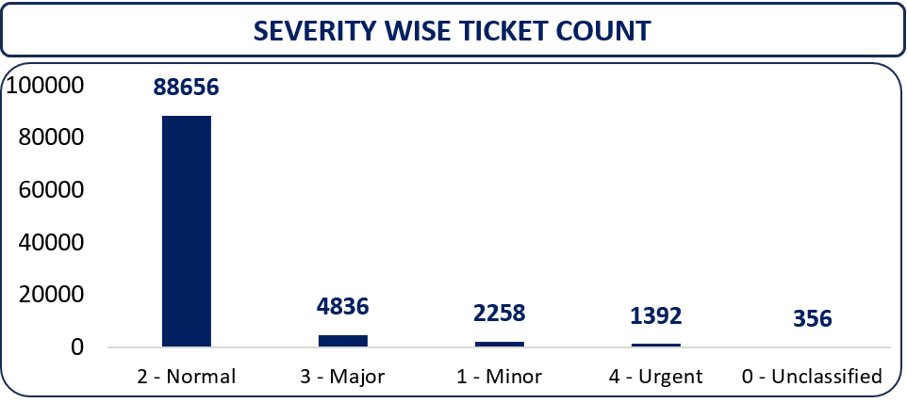
TICKETS BY SEVERITY RATE
The majority of tickets are categorized as Normal severity.
There are a smaller number of Minor severity tickets.
Urgent severity tickets represent a relatively smaller number of tickets
These metrics highlight workload and resource allocation needs for IT agents.

Slide 9
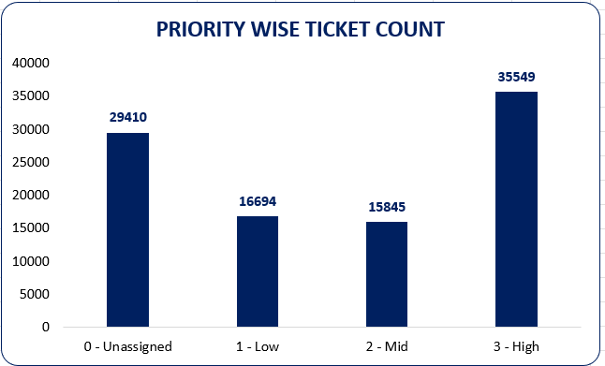
TICKETS BY PRIORITY
The highest number of tickets falls under High priority.
The large number of unassigned tickets is concerning.
The medium-priority tickets fall in between high and low, making up a fairly large portion of the ticket pool.

Slide 10


Agent Performance & Resolution Insights
Tickets Handled by Agent
Categorical vs. Continuous Data
Agent Name
Tickets
Categorical Columns: 12
John Smith
1250
Continuous Columns: 3
Jane Doe
1180
Mike Ross
1000
Sarah Connor
950
Daily Average Resolution Time
Overall average: 4.55 days
Issue Type Count
Understanding agent workload and resolution efficiency is vital for performance optimization.

Slide 11

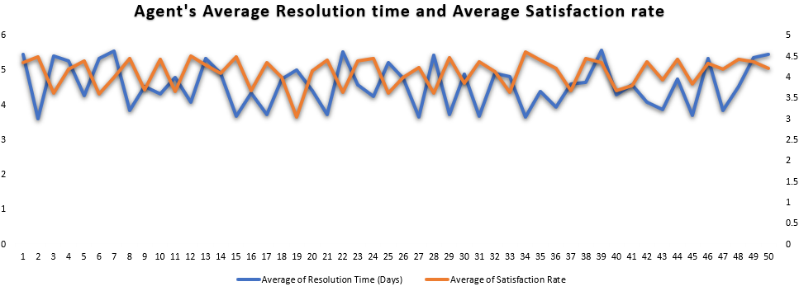
Targeted Agent Training
Identify Underperforming Agents
Filter agents with above-average resolution times and below-average satisfaction ratings.
Agents Identified
Agent ID 25: Longest resolution time
Agent ID 38: Lowest satisfaction rate
Agent ID 12: High resolution, low satisfaction
Training Focus
Improve efficiency and enhance customer satisfaction through targeted skill development.
Personalized training programs are key to elevating overall team performance.

Slide 12
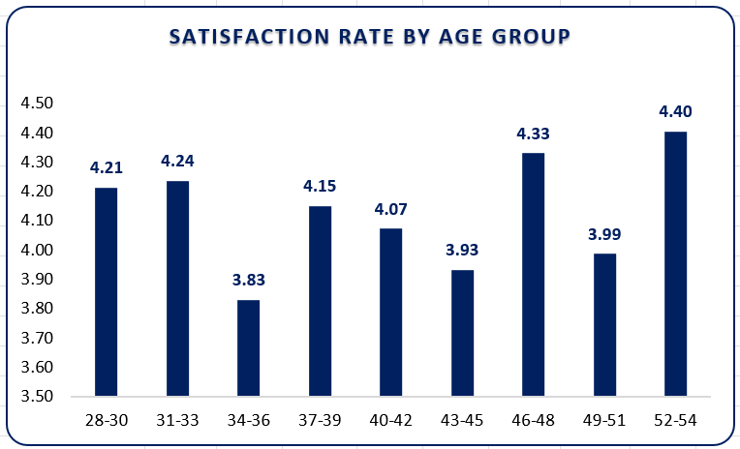
SATISFACTION RATE BY AGE GROUP
The satisfaction rate increases in (46 – 48) age group, indicating that users in their late 40s may be experiencing a higher level of satisfaction with the service. This could be related to factors such as more experience or better expectations alignment.
These age groups (34 – 36) experience the lowest satisfaction, particularly age 34, which stands out with a significant dip in satisfaction. There might be factors affecting this age group, like expectations, service delivery, or a specific issue that needs to be addressed.
The satisfaction rates for 28 (4.26) and 29 (4.14) are relatively high compared to other age groups, indicating a positive experience in younger adults.

Slide 13
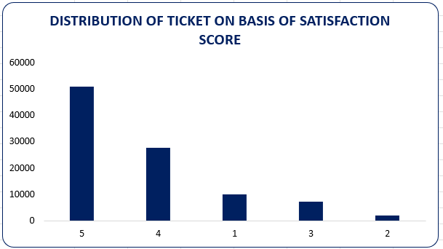
TICKETS BASED ON SATISFACTION SCORE
High Satisfaction: The majority of tickets are rated highly (scores 4 and 5), indicating that IT support is generally meeting or exceeding expectations.
Low Satisfaction Focus: However, a notable portion of tickets (around 15.6%) are rated with low satisfaction scores (1-3), indicating areas where support could be improved. This group represents an opportunity to analyze and improve the underlying causes of dissatisfaction or neutrality

Slide 14
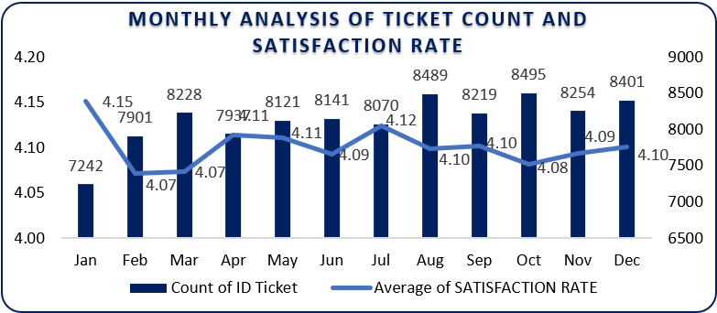
MONTHLY ANALYSIS OF TICKET COUNT AND SATISFACTION RATE
The ticket volume fluctuates monthly, with January having the lowest ticket volume (7,242) and October and August
having the highest volumes (8,495 and 8,489, respectively).
The average satisfaction rate remains relatively stable throughout the year, fluctuating between 4.07 and 4.15.
In January, when ticket volume is at its lowest, the satisfaction rate is 4.15, which is the highest of the year.
While satisfaction remains high, there is a slight dip in satisfaction rates during the peak months of February, March,
and October, were the average rating drops to 4.07.
Agents Identified
Agent ID 25: Longest resolution time
Agent ID 38: Lowest satisfaction rate
Agent ID 12: High resolution, low satisfaction
Training Focus
Improve efficiency and enhance customer satisfaction through targeted skill development.
Personalized training programs are key to elevating overall team performance.

Slide 15
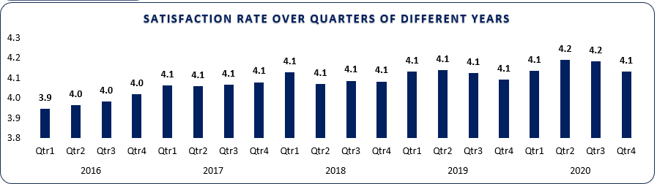
SATISFACTION RATE OVER QUARTER OF DIFFERENT YEARS
The overall trend reflects a significant improvement in the IT support team's performance from 2016 to 2020, indicating effective enhancements in customer satisfaction efforts.

Slide 16
KEY INSIGHTS DERIVED FROM THE ANALYSIS
The increasing ticket volume suggests that the business is growing or that users are facing more issues that need attention. This growth can lead to resource strain, so scalable solutions like automation or staffing adjustments are essential.
The frequency of system-related issues and login access points to a need for improving system stability and user access points. For hardware issues, proactive maintenance or better troubleshooting resources can reduce the number of tickets raised
The improvement in satisfaction indicates that the support team is effectively addressing user issues. However, maintaining or boosting satisfaction further will require continuous monitoring and addressing any emerging service gaps.
A significant number of tickets are rated 4 (27,562) and 5 (50,770), showing overall positive experiences with support. However, there’s still a sizeable group rating tickets as 1 or 2 (12,884 combined), indicating areas for improvement.
Login access issues have the shortest resolution time (0.31 hours across all quarters), while hardware issues have the longest resolution time (7.55 hours in Q4)
The majority of tickets are categorized as unassigned (29,410), with a significant portion marked low priority (16,694) and high priority tickets (35,549) making up a smaller portion

Slide 17
SPECIFIC RECOMMENDATIONS
Always ensure that high-severity tickets are addressed first.
Set up alerts about the unassigned ticket to any senior managers.
We can also pair high-performing agents with those needing improvement.
Assign senior agents to guide newer or struggling agents.
Identify the areas in which the agent is underperforming, such as communication issues or lack of technical knowledge/skills.
Check if the agent is using proper troubleshooting steps to resolve the query and train the agent with the software and troubleshooting methods.
Speed up ticket resolution times by providing ready access to solution for common issues
Can handle increasing ticket volumes by hiring more agents and providing necessary trainings
Timely resolutions will enhance satisfaction ratings.

Slide 18
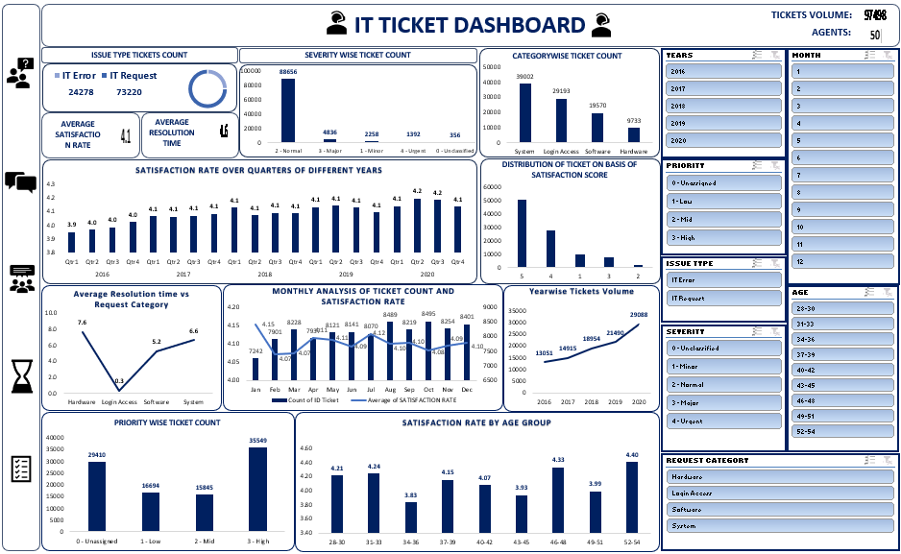
Dashboard for Comprehensive Performance View

Slide 19
CONCLUSION
Ticket volume Trends :
Peak Times : High ticket volumes observed during specific periods such as system updates
Recurring Issues : Login issues and software related repeated issues can be provided with documented solutions
Resolution Time :
Delays in resolution : Average resolution time for critical tickets is above SLA thresholds
Bottlenecks identified : Specific agents causing delays (lack of skills or missing expertise)
Categorization and Prioritization :
Tickets are often miscategorized, leading to delays in routing and resolution
User Feedback :
Poor satisfaction ratings linked to delayed responses and lack of follow-up communication
Resource Allocation :
Understaffing during peak periods leading to backlog accumulation

Slide 20
RECOMMENDATIONS
Automation and Self-Service : Implement self-service portals and automated workflows for common issues
Process Improvements : Streamline ticket routing processes to minimize misclassification
Resource Optimization : Adjusting staffing levels based on historical volume trends, train junior agents to handle medium-complex tickets to reduce dependency on senior agents
Enhanced Monitoring and Analytics : Regularly review SLA performance and resolution time trends
Knowledge Base Development : Expand and regularly update guides, documents containing recurring issues to reduce ticket inflow

Slide 21


